Slide 1
Chongqing University of Technology
ATAI
Advanced Technique of Artificial Intelligence
Chongqing University of Technology
Disentangled Cascaded Graph Convolution Networks for Multi-Behavior
Recommendation
—— ACM 2024
Code：https://github.com/JianhuaDongCS/Disen-CGCN
2024.7.11 • ChongQing
Reported by Peng Shan

Slide 2
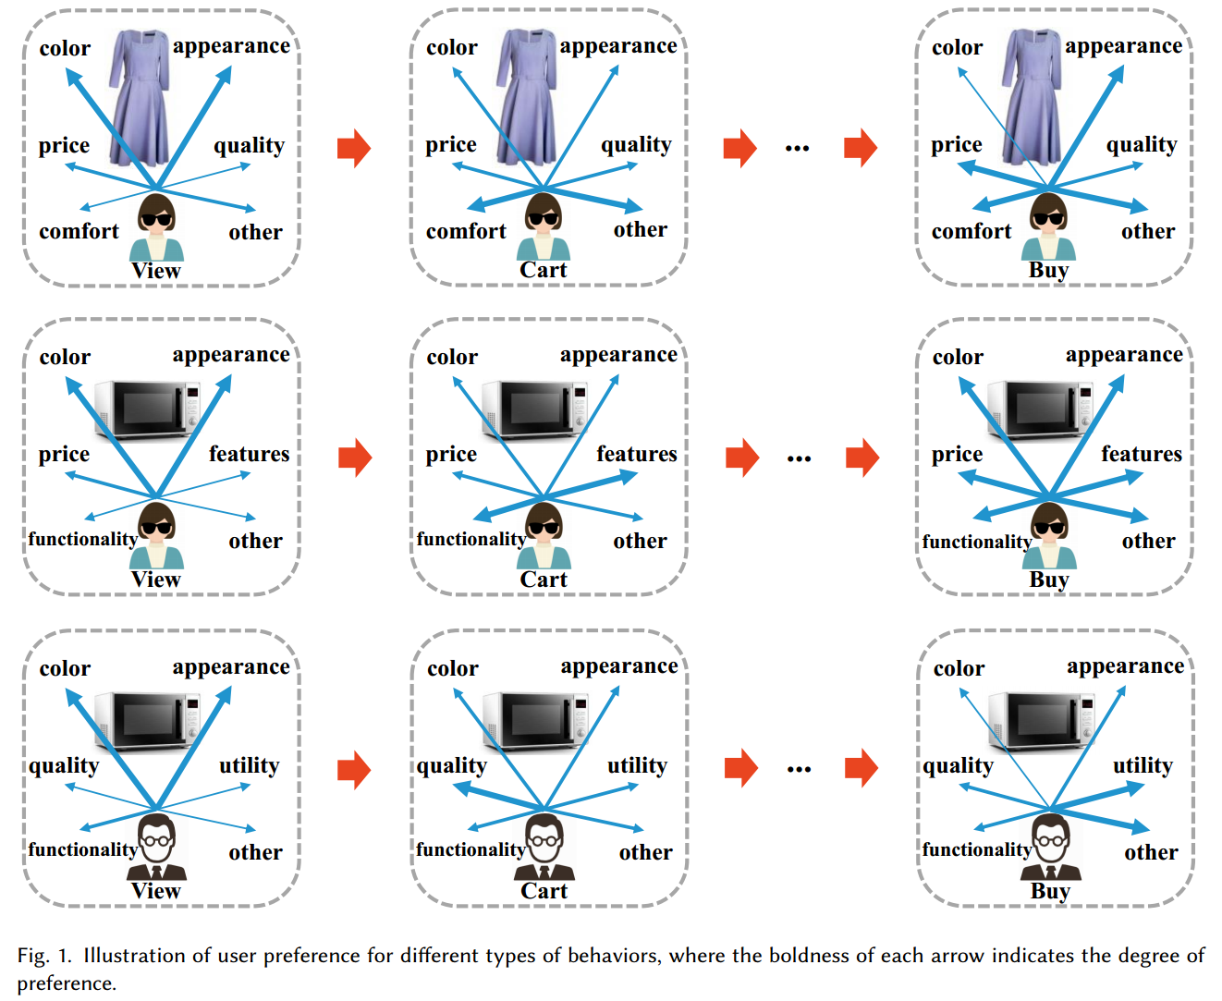
Motivation
（1）Existing methods fall short in capturing the nuanced preferences users exhibit towards items across different behaviors.
（2）They typically use a shared feature transformation function. However, preference patterns can vary significantly among individuals across different behaviors. A common transformation may not effectively personalize this process for individual users and items.

Slide 3
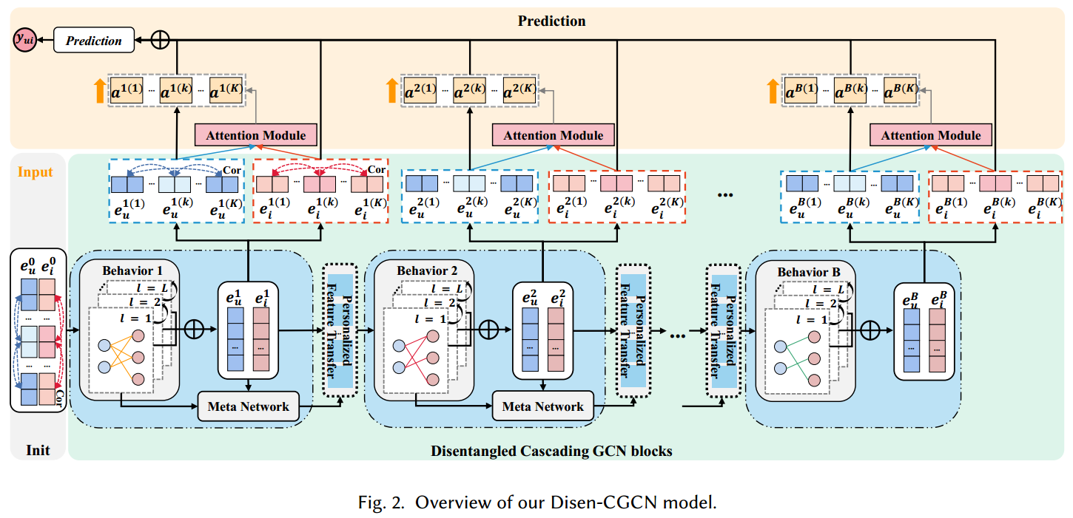
Method

Slide 4
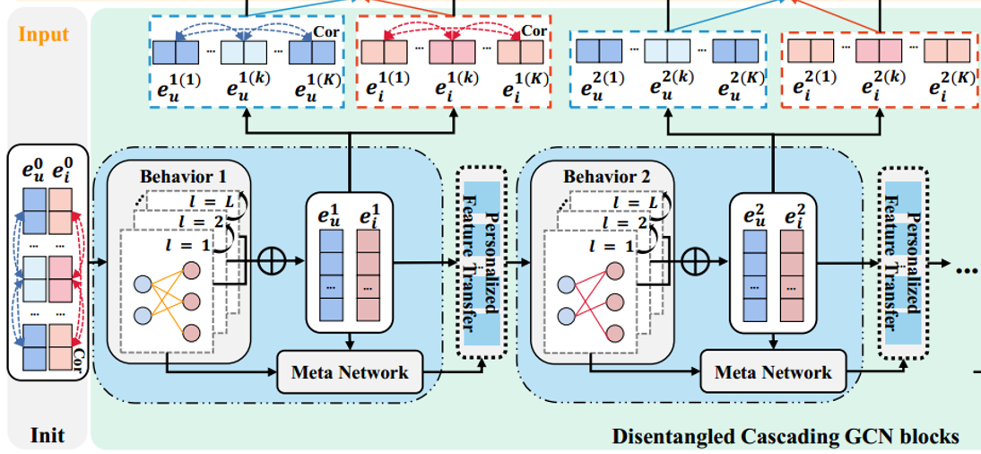
Method

Slide 5
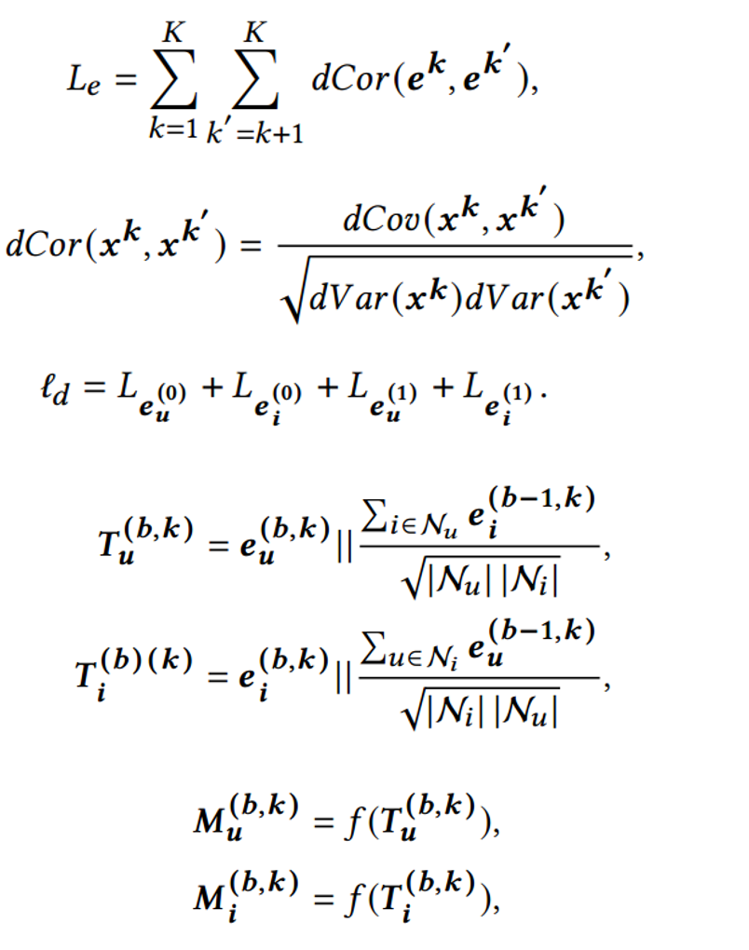
Method

Slide 6
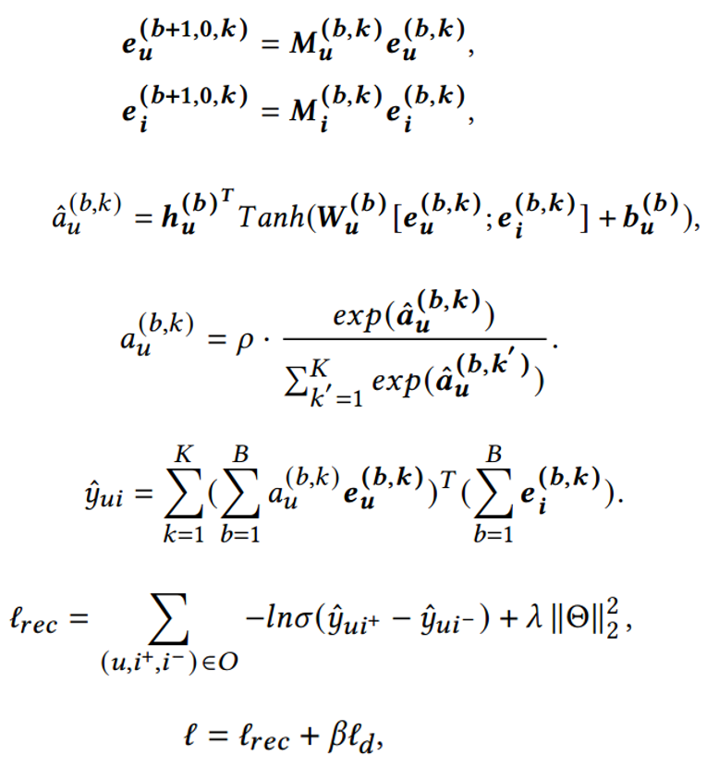
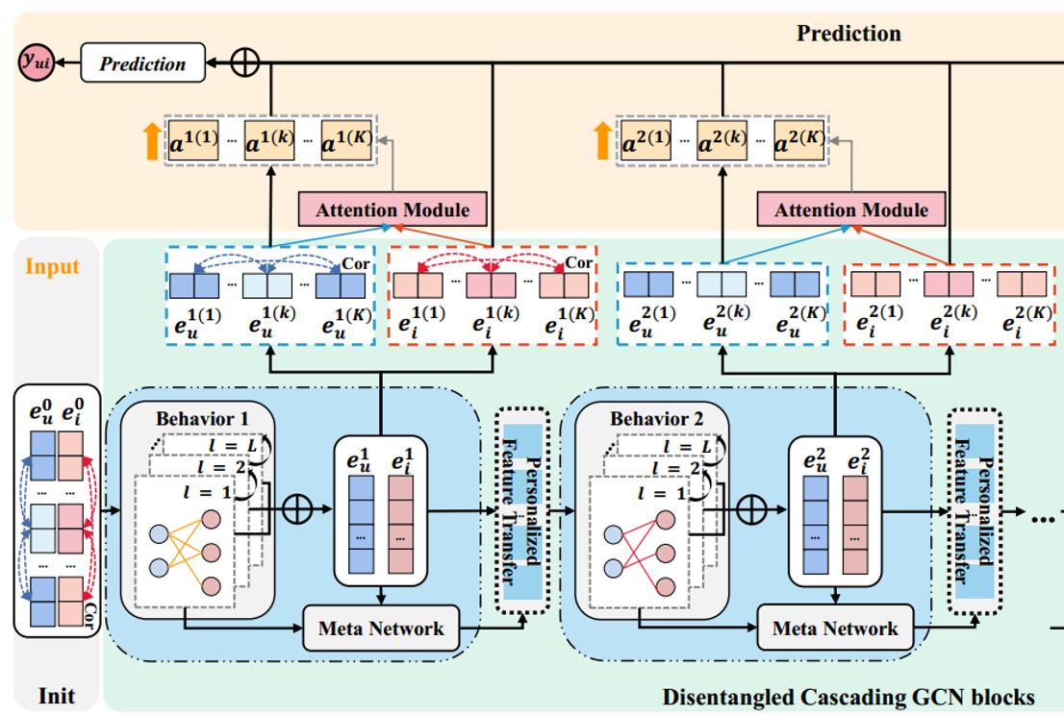
Method

Slide 7
Experiments

Slide 8
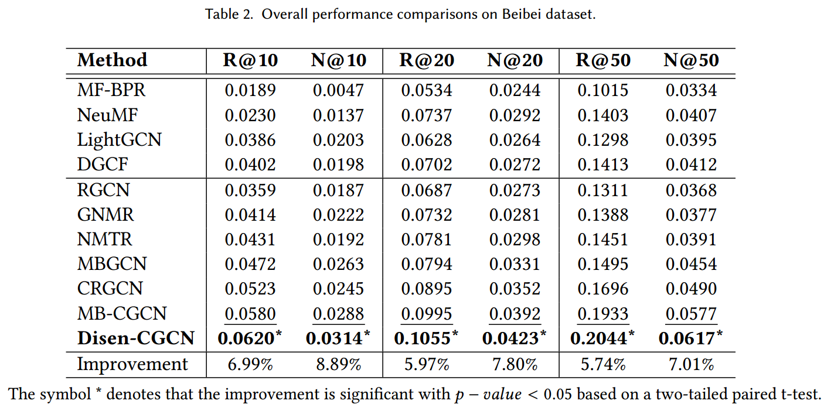
Experiments

Slide 9
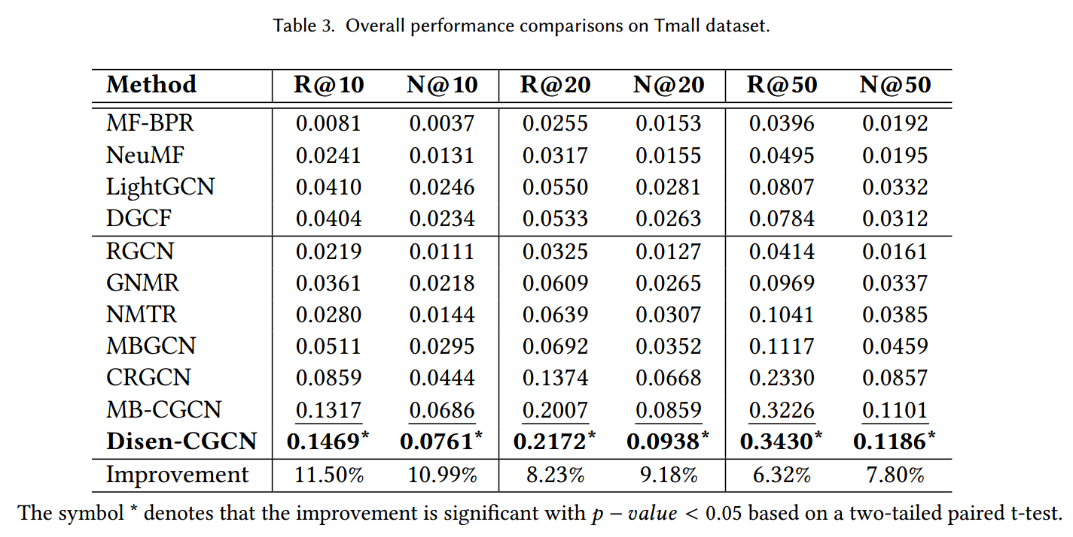
Experiments

Slide 10
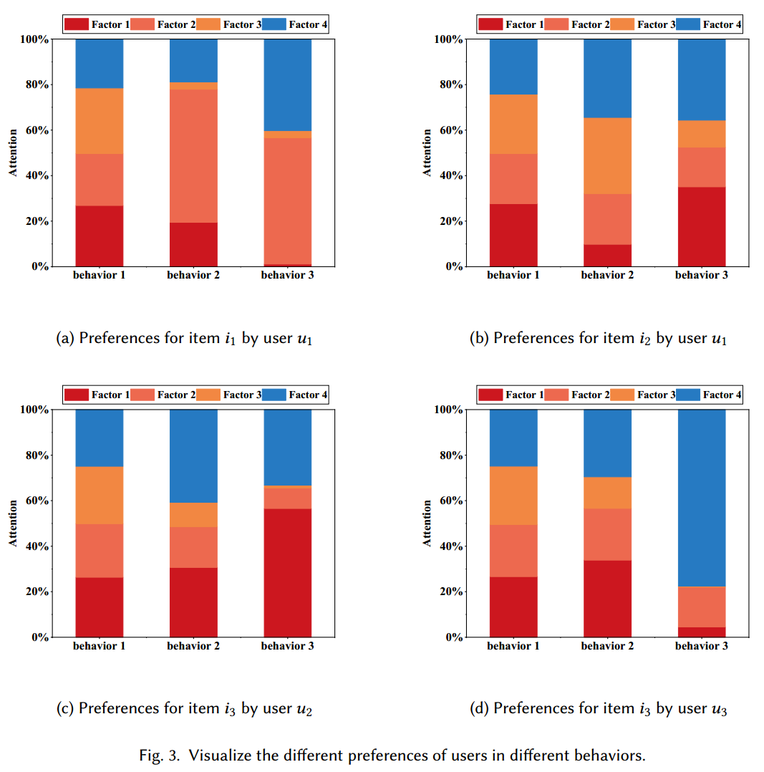
Experiments

Slide 11
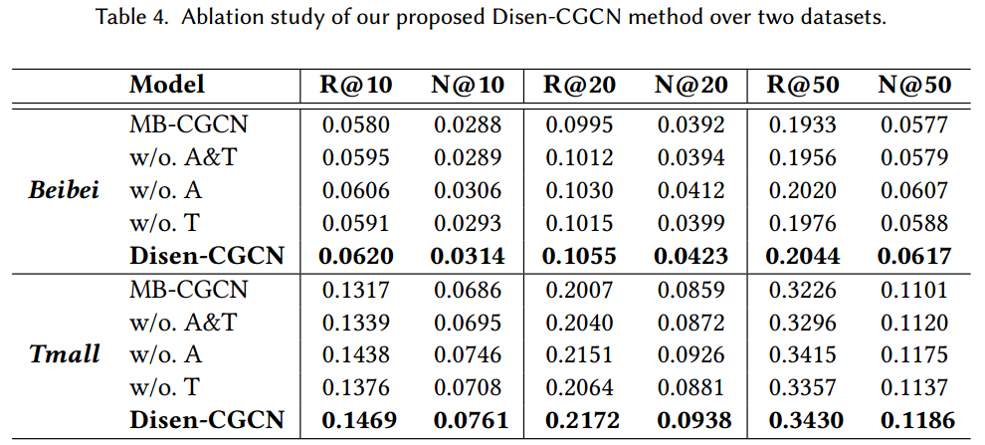
Experiments

Slide 12
Experiments

Slide 13
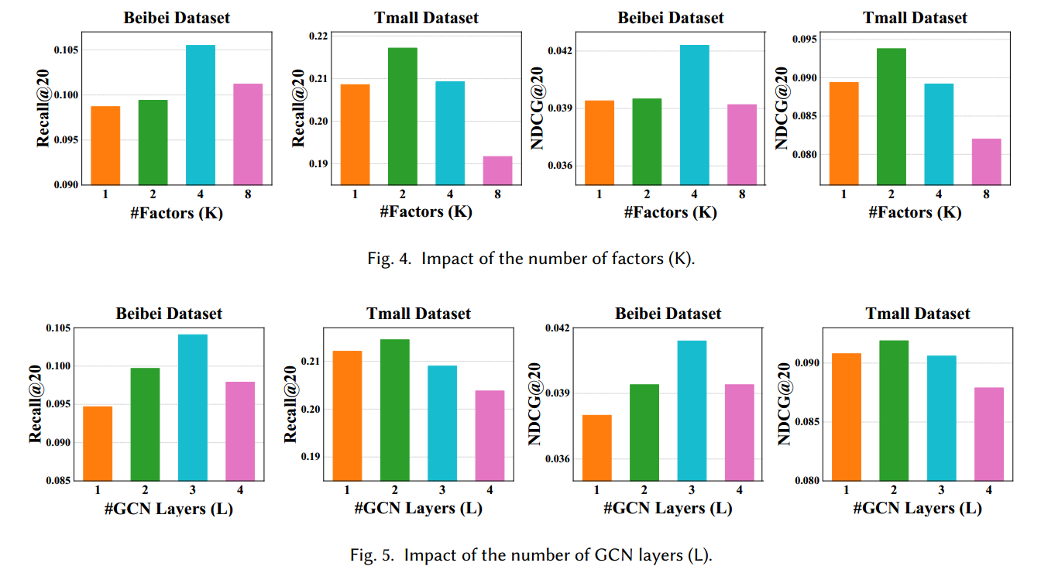
Experiments

Slide 14
Experiments

Slide 15
Thanks!

